Slide 1
Game Design & Development

Slide 2

Game Design & Development Santa‘s Christmas Run Game Design Document TEAM_CK Kevin Kuntz, Christopher Biehl, Alexander Huber

Slide 3
Table of contents
Gameplay
Genre
Mechanics
Difficulties
Game world
Settings
Map generation
Future: Monetization(?)
Game outline
Concept
Story
Sprites
Character
Appearance

Slide 4
Player plays a 2D character in a 2D world
Player will be able to
collect items
gain points
future: kill enemies?

Slide 5

Player will achieve a highscore
Map will be generated procedural, more about this later ..
our main focus

Slide 6
25th of december
Santa Claus delivered all the presents
Someone steals all the presents
Santa needs to find them

Slide 7
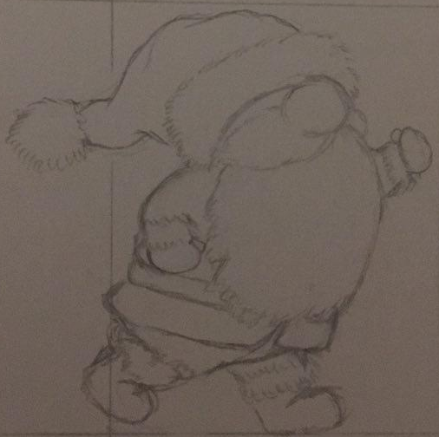
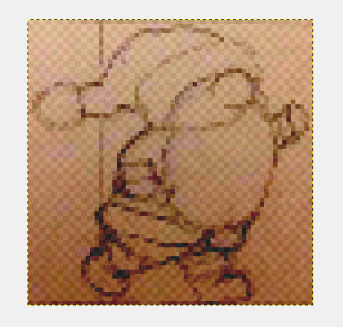
imagine your item
draw and scan it
load it into a new image and reduce opacity

Slide 8
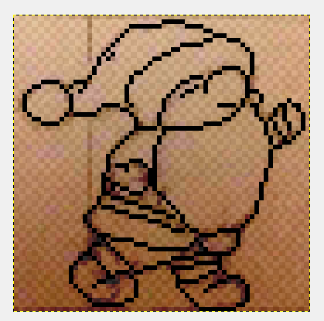

draw the outlines
paint the sprite with fitting colors

Slide 9

playable character: Santa Claus
starting as a simple classic santa
future: maybe spend collected points on a new santa sprite

Slide 10
Genre
endless runner
2D Jump ‘n‘ Run
pixel graphics
with procedurally generated map
high replayability
Notes:
This means, every time you start the game , you are facing a new map.
We want to achieve a high replayability for the customer .

Slide 11
Movement
Space / up arrow - jumping
A / left arrow - moving to the left
D / right arrow - moving to the right
If `Space` is pressed once the character will do a normal jump, but when `Space` is hold it jumps higher.
Notes:
For our game we have choosen simple and known mechanics.
Space / up arrow -> jumping
A / left arrow -> moving to the left
D / right arrow -> moving to the right
Space pressed once -> normal jump
Space hold -> higher jump

Slide 12
Difficulties
The speed will be increased
Determined by how much time has elapsed
Enemies
No complex AI
Like the koopas (turtles) known from super mario
Notes:
For the moment there are no enemies supposed.
Because our main feature is the prozedural generation of the map .

Slide 13
Non-intelligent obstacles
Depending on the score some events will take place
Blizzard appears with flying objects
To survive, the player has to avoid those objects
Notes:
After you reached a certain score a blizzard with flying objects will appear .

Slide 14
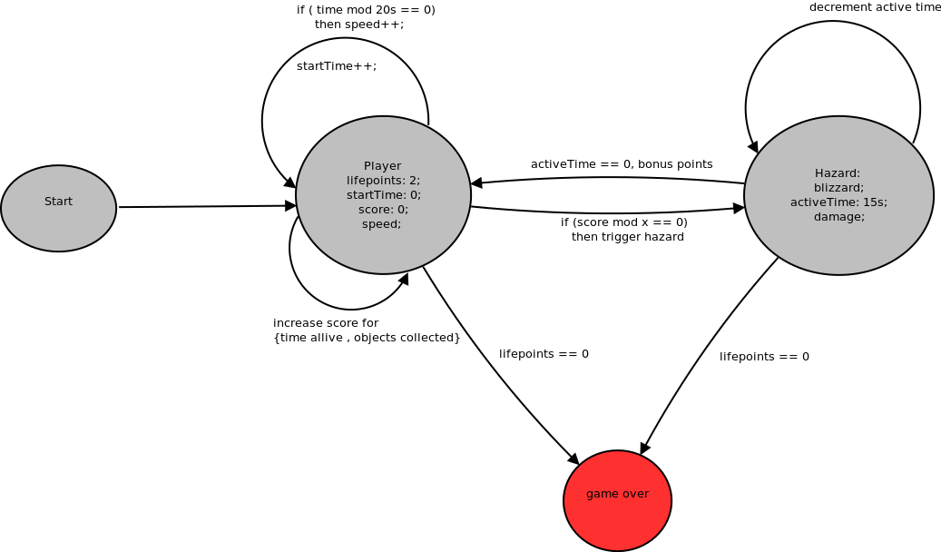
Notes:
Finit state machine shows flow of the game.
Player spawns in the beginning of the map .
Show attributes.
Conditions:
speed increased
time increased
Score increased by -> time alive, objects collected.
Blizzard event has a time counter , which decrements and the blizzard does damage.
Need to be dodged by the player.

Slide 15
one setting
snowy landscape
trees
future: feature to unlock more map-settings?
more in monetization slides

Slide 16
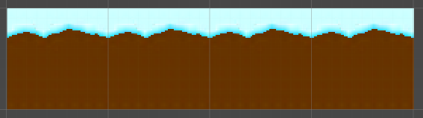
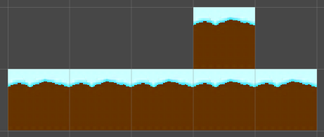

procedural map generation
map will be generated as you play the game
map is made of different platforms
platforms are made of different arrangements of tiles
tiles are little square objects, e.g. 64x64
Notes:
Our main focus will be map generation
map made of different platforms
platforms = different arrangements of tiles
tiles = square objects, e.g 64x64

Slide 17
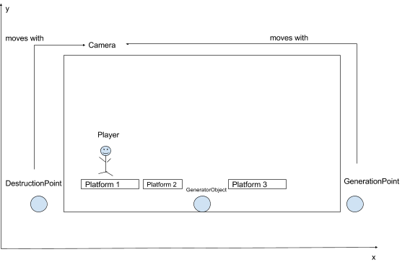
First idea
Notes:
we have our x- and y-axis
we can see the camera, everything inside is what the player is going to see
we can see our player and 3 platforms that are already there
also, we have 3 important objects/points
DestructionPoint
GenerationPoint
both moving with camera
GeneratorObject (algorithm is attached to this object)
How it works
as long as the x-coordinate of our GeneratorObject is less than x-coordinate of GenerationPoint we generate a platform and move GeneratorObject further to the right
if x-coordinate of GeneratorObject happens to be higher than x-coord. of GenerationPoint, then we‘ll just wait until the camera moved further
DestructionPoint checks whether a platform is still in the camera‘s view, and if it isn‘t it‘s going to deactivate that platform (not visible anymore)

Slide 18
Perspective: Monetization
translate highscore points into some sort of in-game currency
use this currency to buy new sprites
offer in-game currency for real money
add advertisements to the game

Slide 19
Thanks
for your attention

Slide 20
Questions
?

